Slide 1


100 Go Mistakes and how to avoid them
SystemGroup Webinar, 8 Amordad 1403
By Teiva Harsanyi
Aryan Ebrahimpour
Abramad
aryan.e@abramad.com

Slide 2
Why this presentation?
01
The Book and The Author
02
The Cherry-picked Mistakes
03
Recommended Mistakes to read
04
Other Good Resources
Today’s (glorious) blather.
05
Questions?
06

Slide 3
Why this presentation?
SECTION ONE

Slide 4


Emerging Go Projects
Why this presentation?

Slide 5
The Book and the Author
SECTION TWO

Slide 6
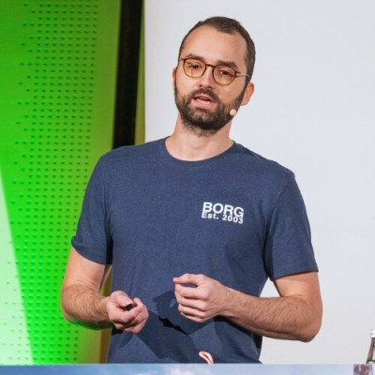
100 Go Mistakes: And how to avoid them
By Teiva Harsanyi
Blog posts to a book
Good examples
Stdlib-aware
Community-aware
The Book and the Author

Slide 7
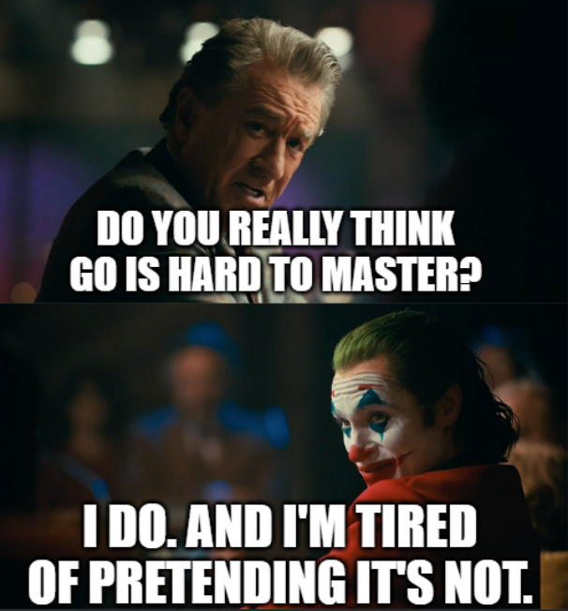
Go
Go is simple to learn, but hard to master
Why this presentation?

Slide 8
Mistake Classes
Bugs
Needless Complexity
Weaker Readability
Suboptimal or unidiomatic organization
Lack of API convenience
Under-optimized code
Lack of productivity
Why this presentation?

Slide 9
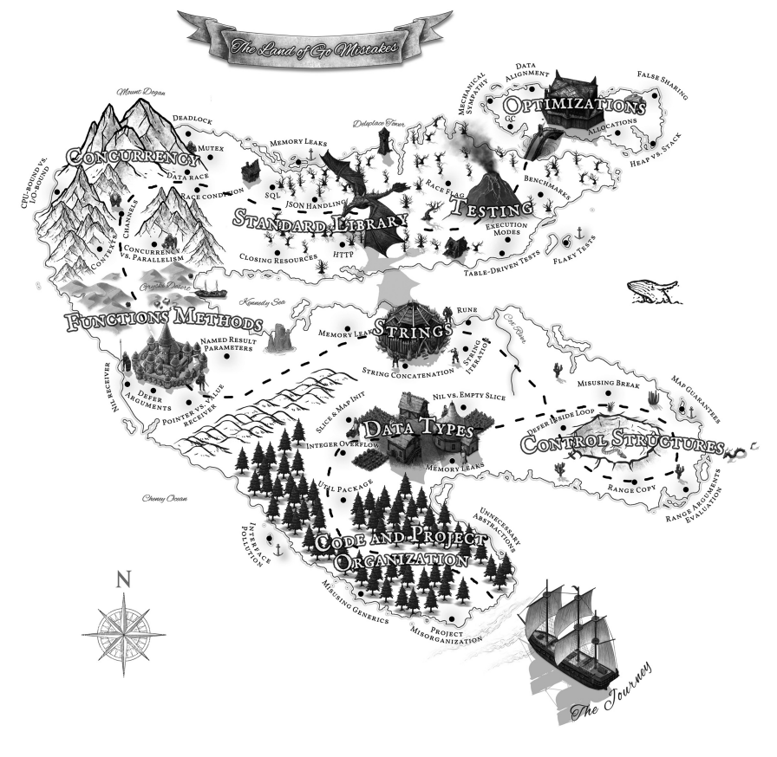
The land of Go mistakes

Slide 10
The Cherry-picked Mistakes
SECTION THREE, LAND ONE
Code and project organization

Slide 11
Mistake #5: Interface Pollution
Overwhelming code with unnecessary abstractions
Common mistake of developers coming from another language
Cherry-picked Mistakes: Land 1 (Code and project organization)

Slide 12
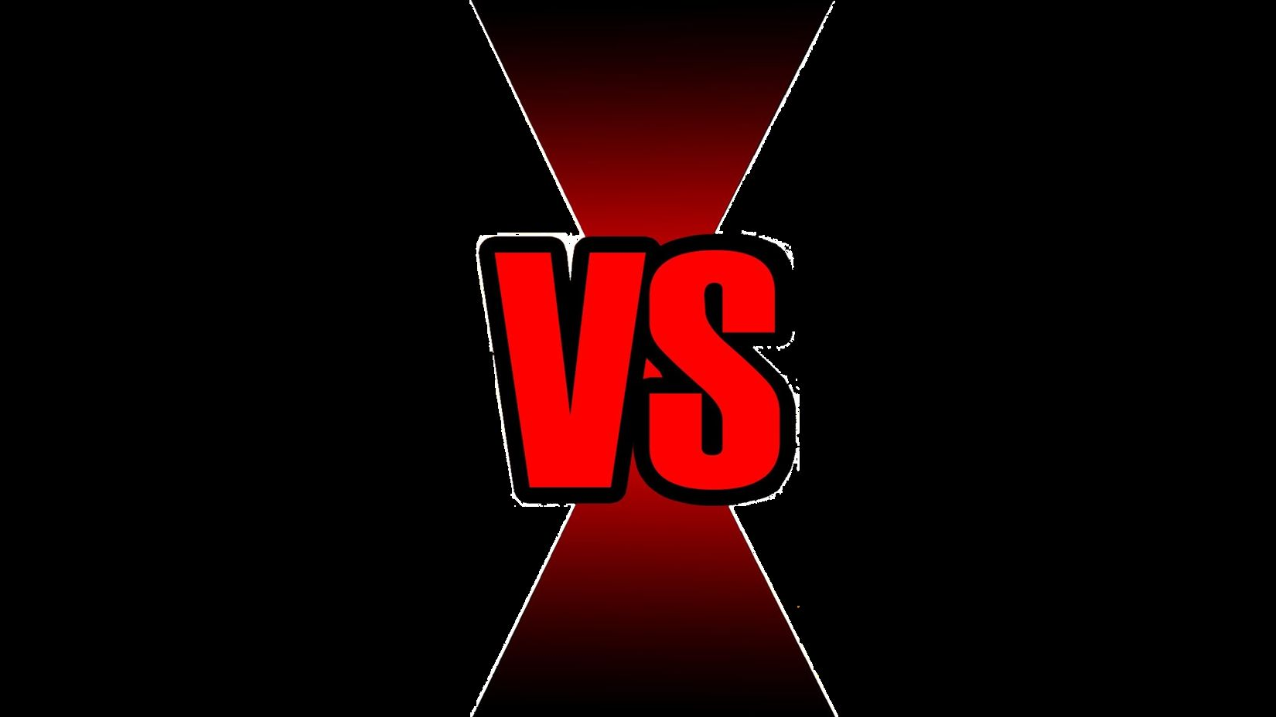



Explicit Interface
Implicit Interface

Slide 13
The bigger the interface, the weaker the abstraction.
ROB PIKE

Slide 14
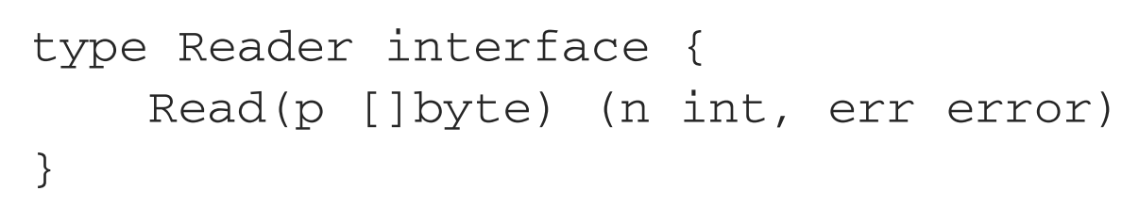
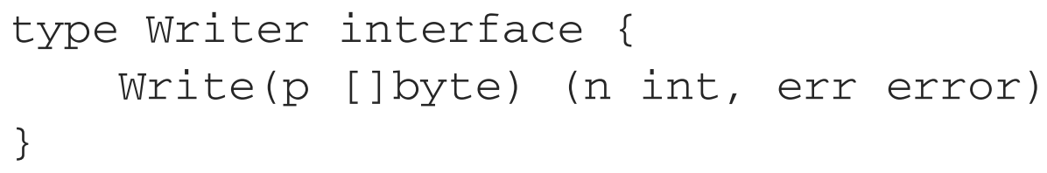
Mistake #5: Interface Pollution
“The bigger the interface, the weaker the abstraction” – Rob Pike
Cherry-picked Mistakes: Land 1 (Code and project organization)

Slide 15
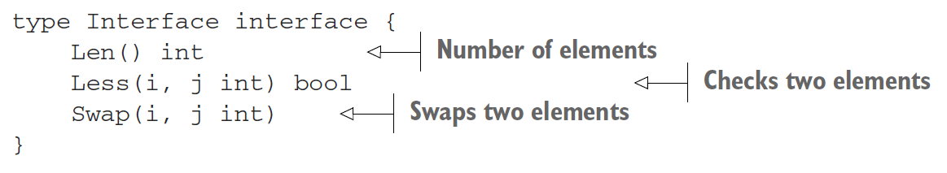
Mistake #5: Interface Pollution
When? (1) Common Behavior
Cherry-picked Mistakes: Land 1 (Code and project organization)

Slide 16
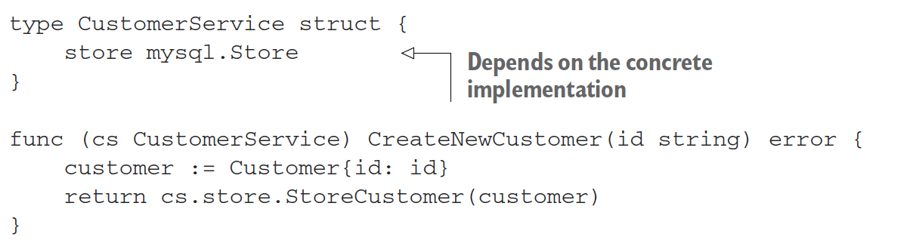
Mistake #5: Interface Pollution
When? (2) Decoupling
Cherry-picked Mistakes: Land 1 (Code and project organization)

Slide 17
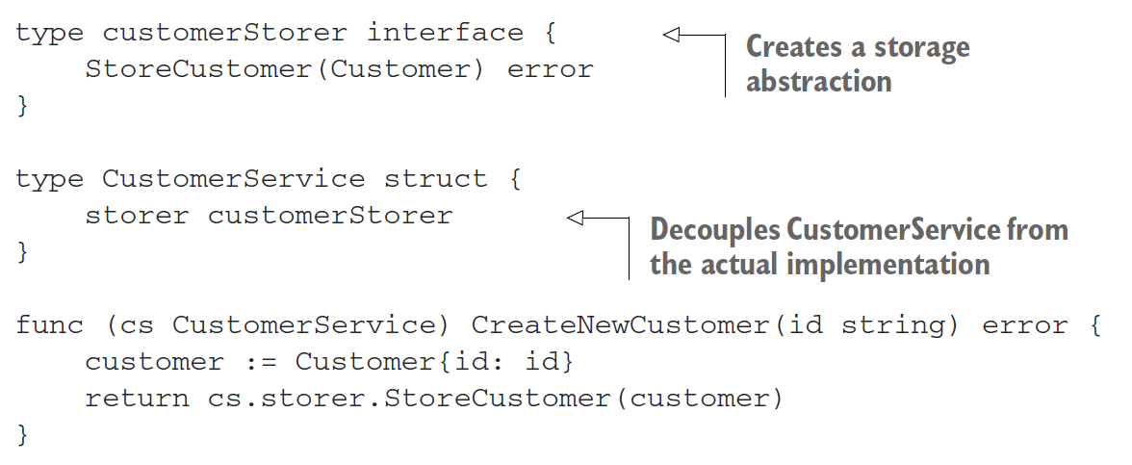
Mistake #5: Interface Pollution
When? (2) Decoupling
Cherry-picked Mistakes: Land 1 (Code and project organization)

Slide 18
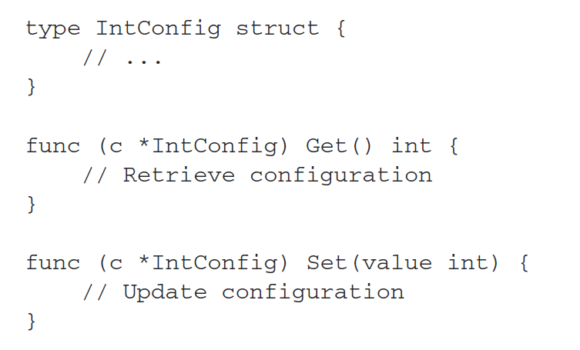
Mistake #5: Interface Pollution
When? (2) Restricting Behavior
Cherry-picked Mistakes: Land 1 (Code and project organization)

Slide 19
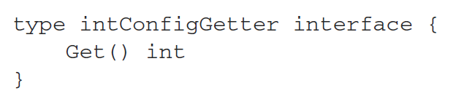
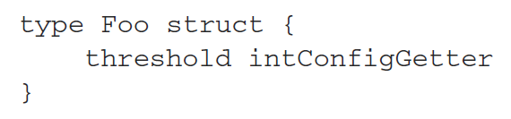
Mistake #5: Interface Pollution
When? (2) Restricting Behavior
Cherry-picked Mistakes: Land 1 (Code and project organization)

Slide 20
Don’t design with interfaces, discover them.
ROB PIKE

Slide 21
Mistake #5: Interface Pollution
“Don’t design with interfaces, discover them” – Rob Pike
We should create an interface when we need it, not when we foresee that we could need it.
Problems with worthless abstractions:
Code is more difficult to read and reason
Performance overhead
Cherry-picked Mistakes: Land 1 (Code and project organization)

Slide 22
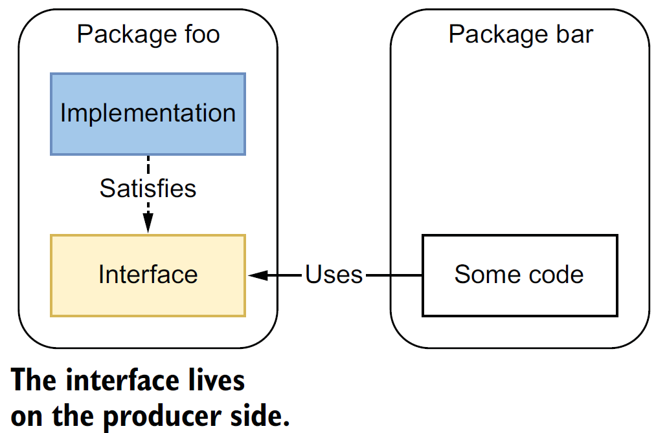
Mistake #6: Interface on the producer side
Where should an interface live?
Cherry-picked Mistakes: Land 1 (Code and project organization)

Slide 23
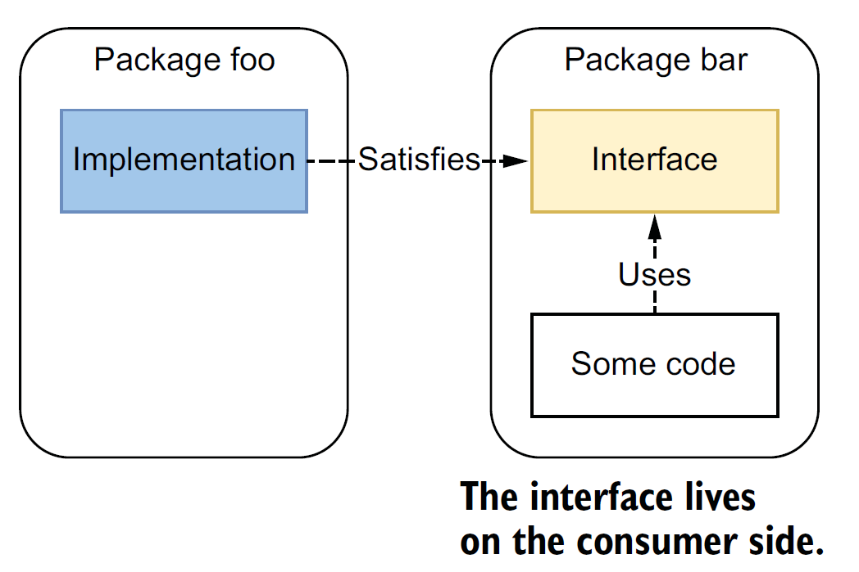
Mistake #6: Interface on the producer side
Where should an interface live?
Cherry-picked Mistakes: Land 1 (Code and project organization)

Slide 24
Producer-side Interface
Consumer-side
Interface

Slide 25
Mistake #6: Interface on the producer side
Go interfaces are implicit
Abstractions should not be created, but discovered
Don’t force abstractions for all the clients.
Stdlib exception:
“encoding” package
Language designers knew, not foresee
Cherry-picked Mistakes: Land 1 (Code and project organization)

Slide 26
Mistake #7: Returning interfaces
Returning interfaces is bad practice in Go
Cherry-picked Mistakes: Land 1 (Code and project organization)

Slide 27
Returning Interfaces
Returning concrete impl

Slide 28
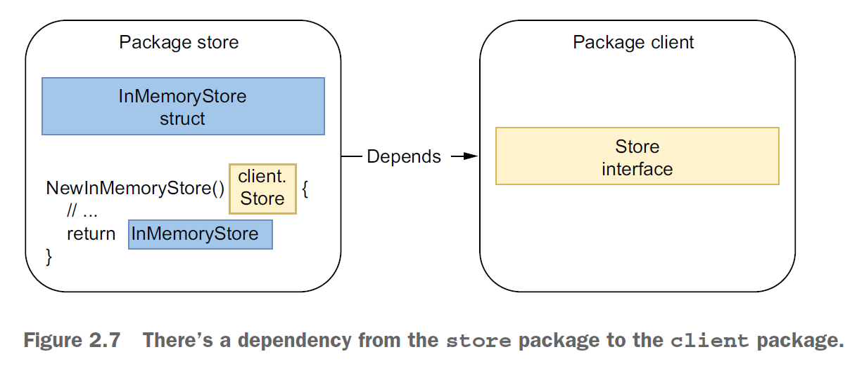
Mistake #7: Returning interfaces
Cherry-picked Mistakes: Land 1 (Code and project organization)

Slide 29
Be conservative in what you do, be liberal in what you accept from others.
Transmission Control Protocol
(https://datatracker.ietf.org/doc/html/rfc761)

Slide 30
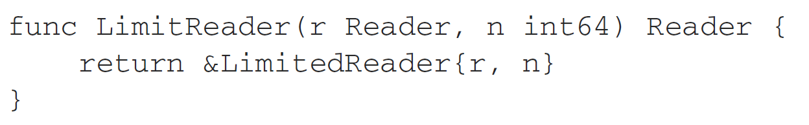
Mistake #7: Returning interfaces
Exceptions:
The error type
LimitReader function
Cherry-picked Mistakes: Land 1 (Code and project organization)

Slide 31
The Cherry-picked Mistakes
SECTION THREE, LAND TWO
Data Types

Slide 32
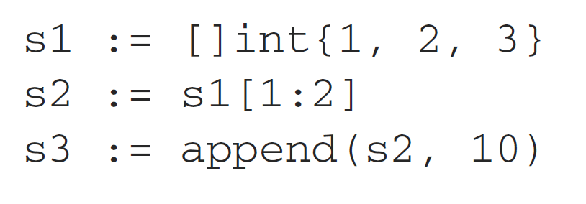
Mistake #25: Unexpected side effects using append
What is the output of this code?
Cherry-picked Mistakes: Land 2 (Data Types)

Slide 33
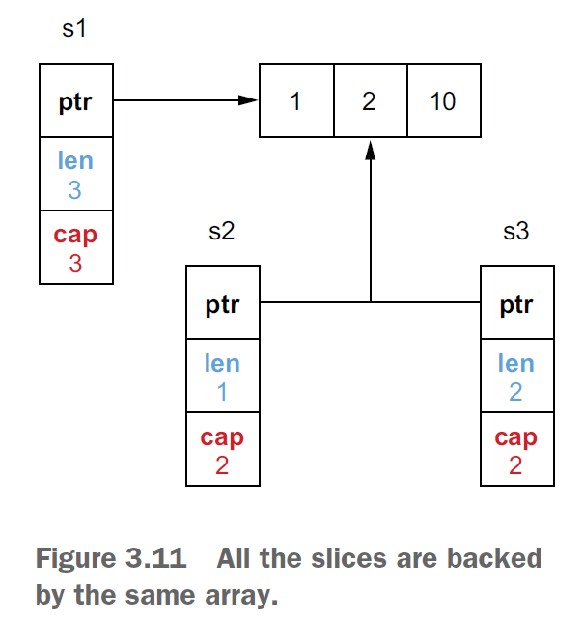
Mistake #25: Unexpected side effects using append
Cherry-picked Mistakes: Land 2 (Data Types)

Slide 34
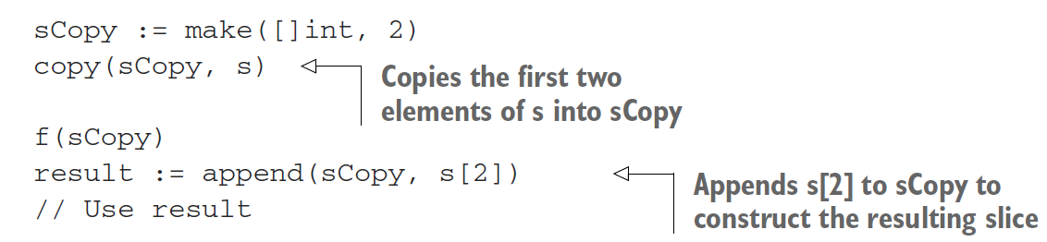
Mistake #25: Unexpected side effects using append
Solution 1:
Cherry-picked Mistakes: Land 2 (Data Types)

Slide 35
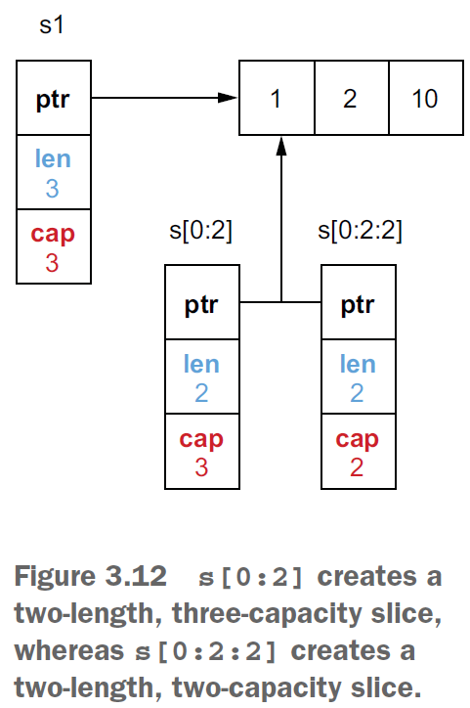
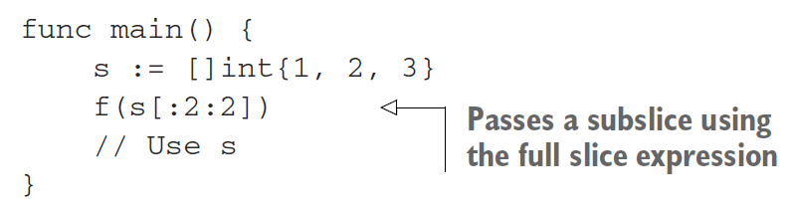
Mistake #25: Unexpected side effects using append
Solution 2:
Cherry-picked Mistakes: Land 2 (Data Types)

Slide 36
Mistake #26: Slices and memory leaks
Slicing an existing slice or array can lead to memory leaks
Cherry-picked Mistakes: Land 2 (Data Types)

Slide 37
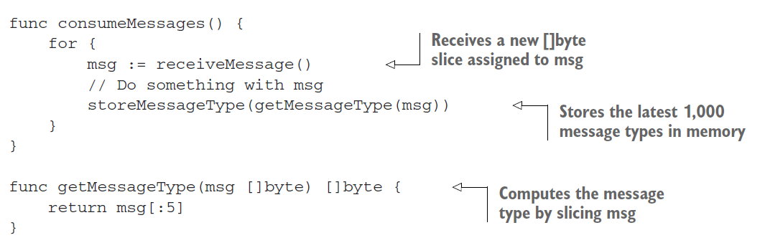
Mistake #26: Slices and memory leaks
Leak (1): Leaking capacity
Cherry-picked Mistakes: Land 2 (Data Types)

Slide 38
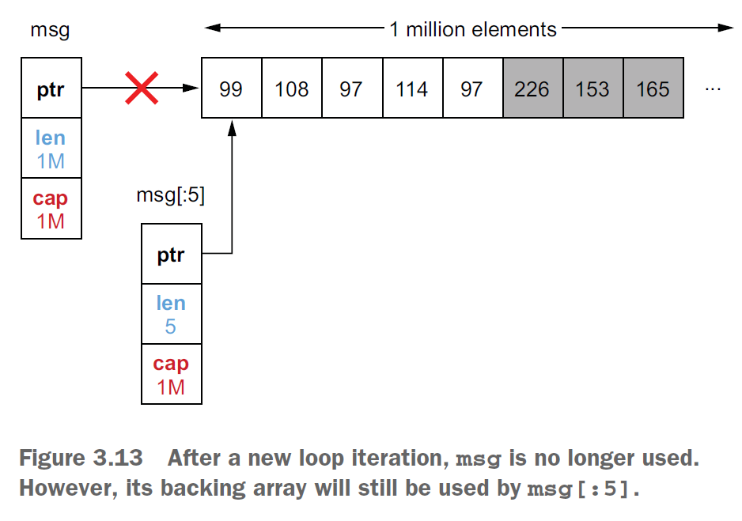
Mistake #26: Slices and memory leaks
Cherry-picked Mistakes: Land 2 (Data Types)

Slide 39
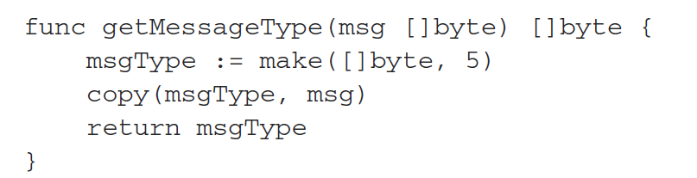

Mistake #26: Slices and memory leaks
Leak (1): Leaking capacity
Slicing a large slice or array can lead to potential HIGH MEMORY CONSUMPTION!
Cherry-picked Mistakes: Land 2 (Data Types)

Slide 40
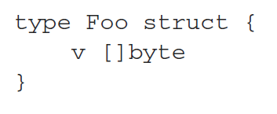
Mistake #26: Slices and memory leaks
Leak (2): Slice and pointers
Cherry-picked Mistakes: Land 2 (Data Types)

Slide 41
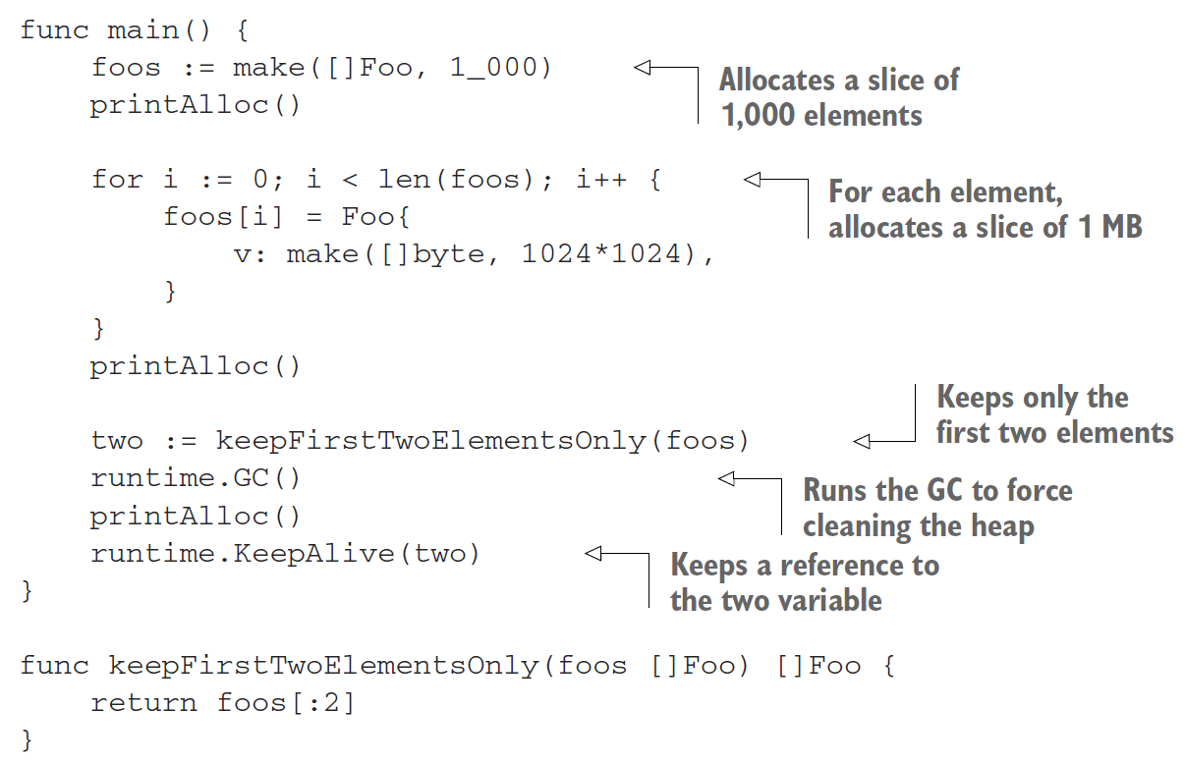
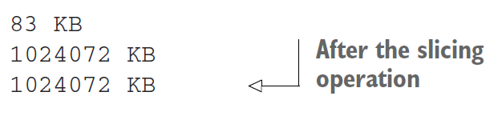
Mistake #26: Slices and memory leaks
Cherry-picked Mistakes: Land 2 (Data Types)

Slide 42
Mistake #26: Slices and memory leaks
Leak (2): Slice and pointers
If the element is a pointer or a struct with pointer fields, the elements won’t be reclaimed by GC.
Cherry-picked Mistakes: Land 2 (Data Types)

Slide 43
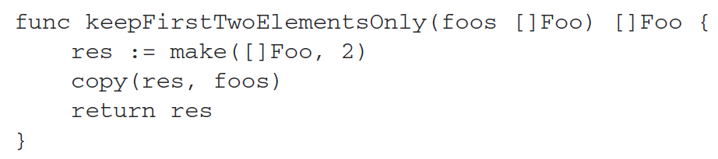
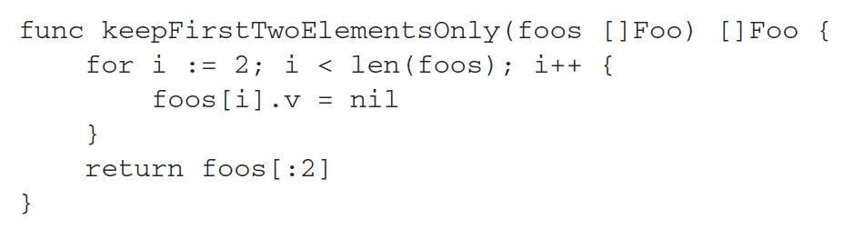
Mistake #26: Slices and memory leaks
Leak (2): Slice and pointers
Cherry-picked Mistakes: Land 2 (Data Types)

Slide 44
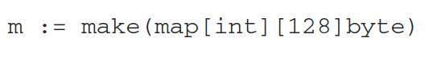
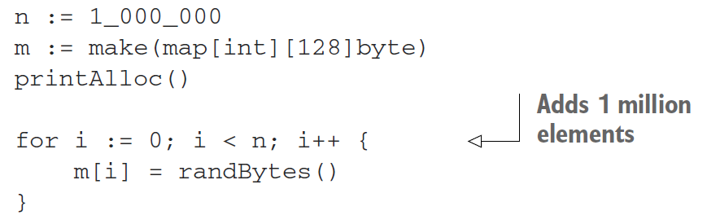
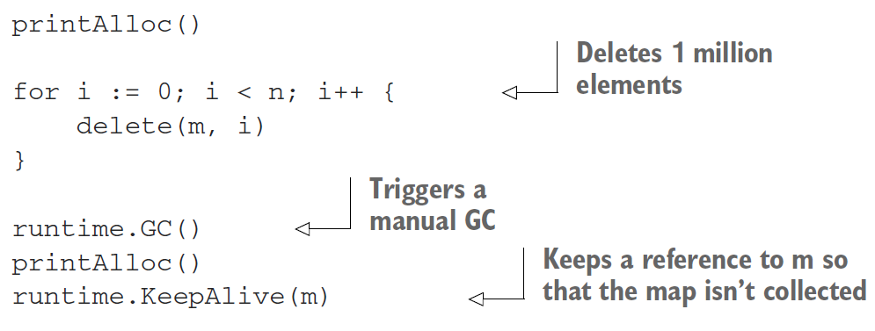
Mistake #28: Maps and memory leaks
Cherry-picked Mistakes: Land 2 (Data Types)

Slide 45
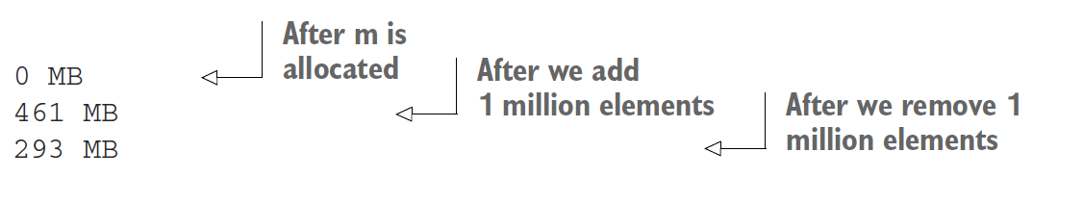
Mistake #28: Maps and memory leaks
Cherry-picked Mistakes: Land 2 (Data Types)

Slide 46
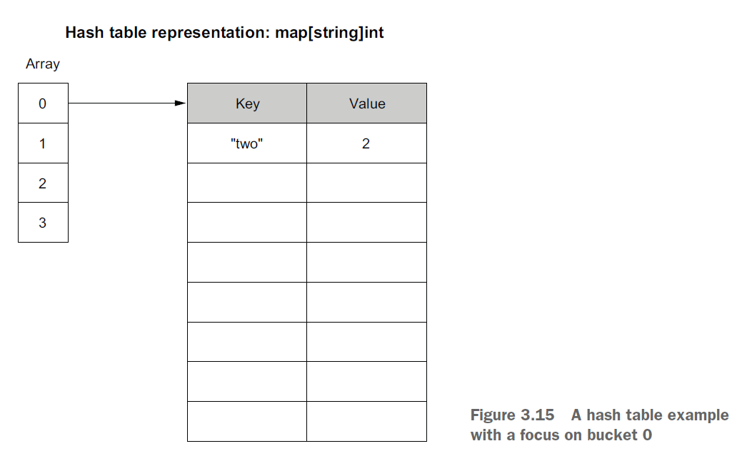
Mistake #28: Maps and memory leaks
Cherry-picked Mistakes: Land 2 (Data Types)

Slide 47
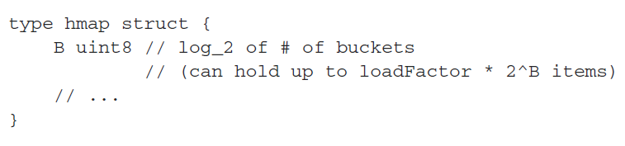
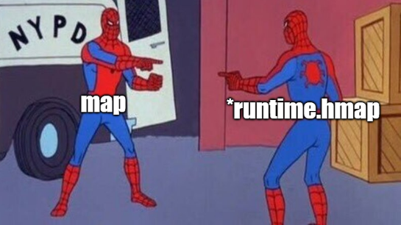
Mistake #28: Maps and memory leaks
Cherry-picked Mistakes: Land 2 (Data Types)

Slide 48
Mistake #28: Maps and memory leaks
Number of buckets in a map NEVER shrinks.
Cherry-picked Mistakes: Land 2 (Data Types)

Slide 49
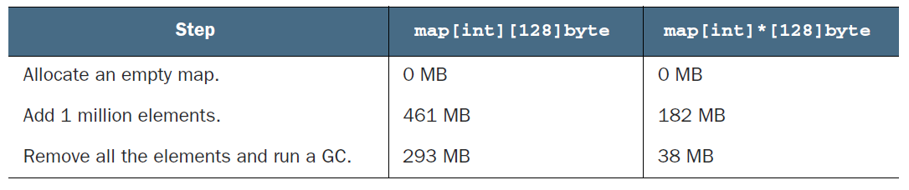
Mistake #28: Maps and memory leaks
Solution (1): re-create the map in regular pace
Drawback: Twice memory usage for a short period
Solution (2): Change map type to store array pointers
Cherry-picked Mistakes: Land 2 (Data Types)

Slide 50
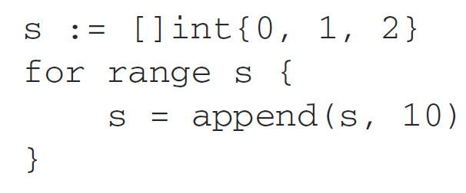
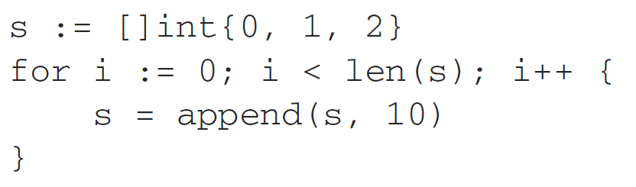
Mistake #31: Ignoring how args are evaluated in range
Is there any difference between these two codes?
Cherry-picked Mistakes: Land 2 (Data Types)

Slide 51
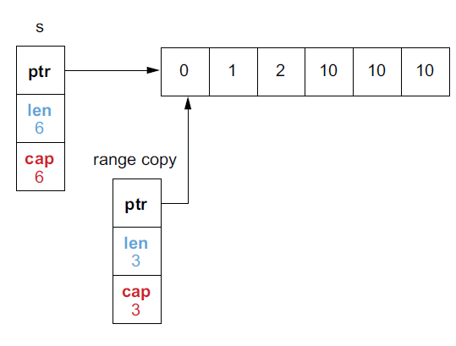
Mistake #31: Ignoring how args are evaluated in range
Cherry-picked Mistakes: Land 2 (Data Types)

Slide 52
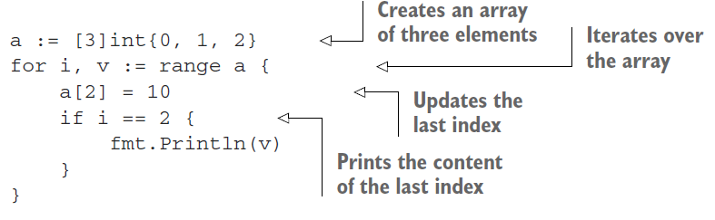
Mistake #31: Ignoring how args are evaluated in range
Cherry-picked Mistakes: Land 2 (Data Types)

Slide 53
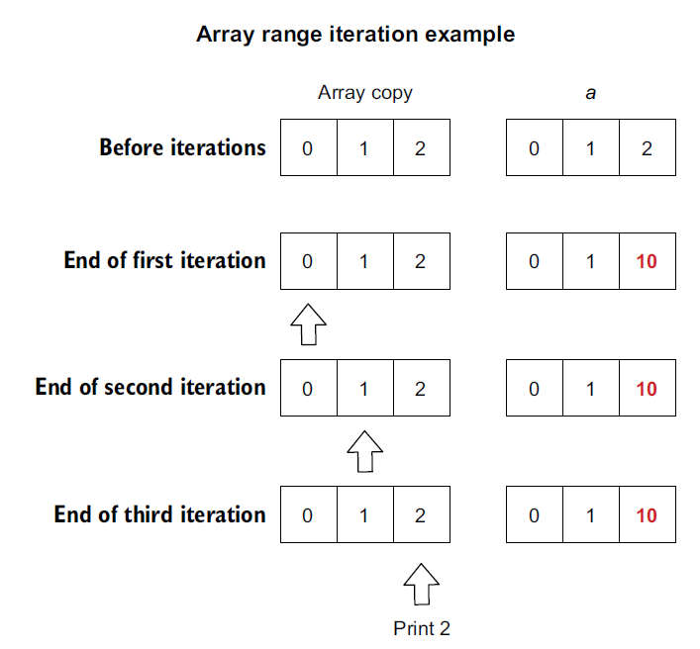
Mistake #31: Ignoring how args are evaluated in range
Cherry-picked Mistakes: Land 2 (Data Types)

Slide 54
Mistake #31: Ignoring how args are evaluated in range
range iterates on a copy of the provided expression.
Cherry-picked Mistakes: Land 2 (Data Types)

Slide 55
Recommended Mistakes to read
SECTION FOUR

Slide 56
Recommended Mistakes to read
Mistake #03: Misusing init functions
Mistake #10: Not using functional options pattern
Mistake #18: Neglecting integer overflows
Mistake #19: Not understanding floating points
Mistake #20: Not understanding slice length and capacity
Mistake #21: Inefficient slice initialization
Mistake #27: Inefficient map initialization
Mistake #29: Comparing values incorrectly
Mistake #32: Ignoring the impact of pointer elements in range loops
Mistake #35: Using defer inside a loop
Mistake #48: Panicking
Mistake #77: Common JSON-handling mistakes
Mistake #99: Not understanding how GC works
Mistake #100: Not understanding the impact of running Go in Docker and Kubernetes
Recommended mistakes to read

Slide 57
Other Good Resources
SECTION FIVE

Slide 58
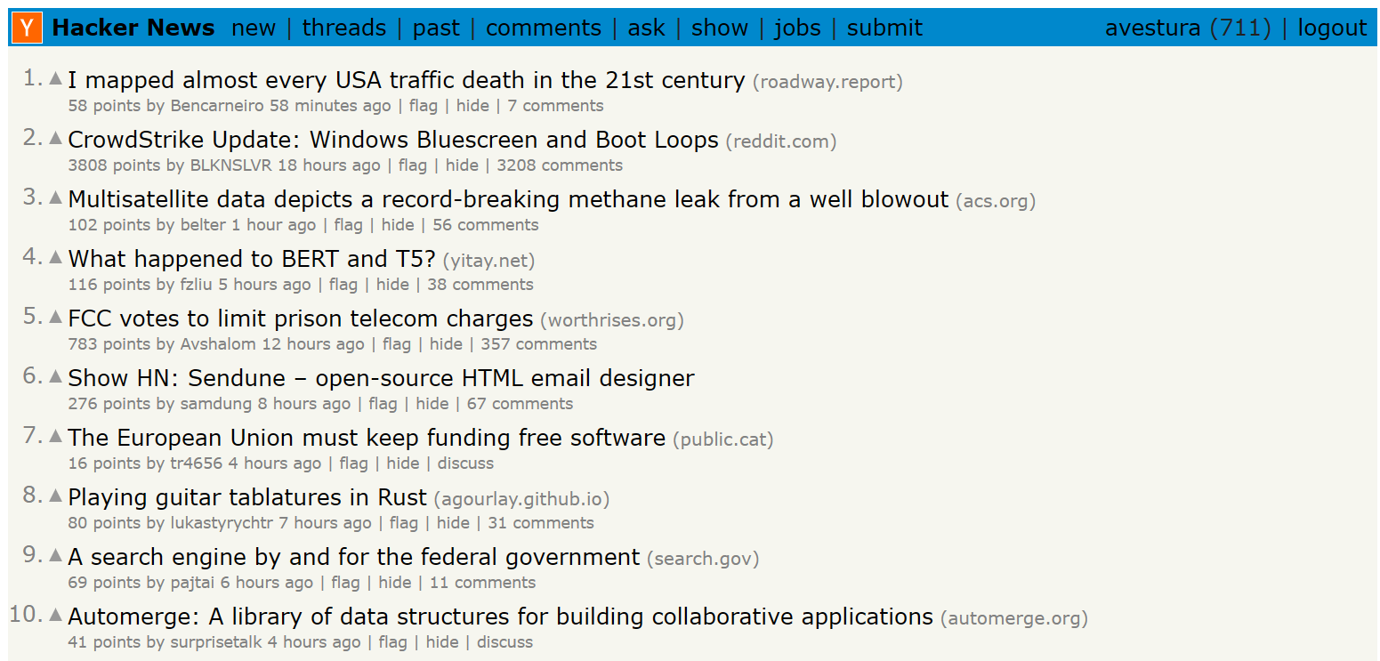

Slide 59
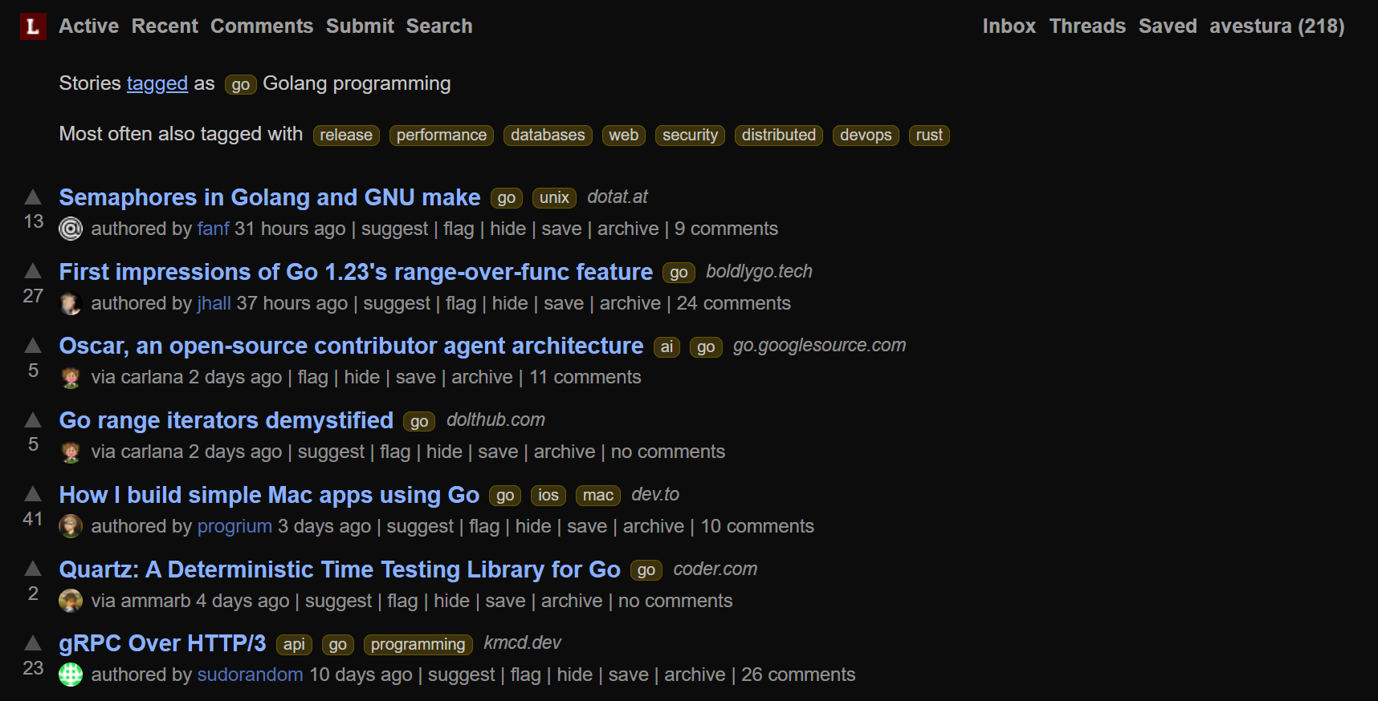

Slide 60


Slide 61
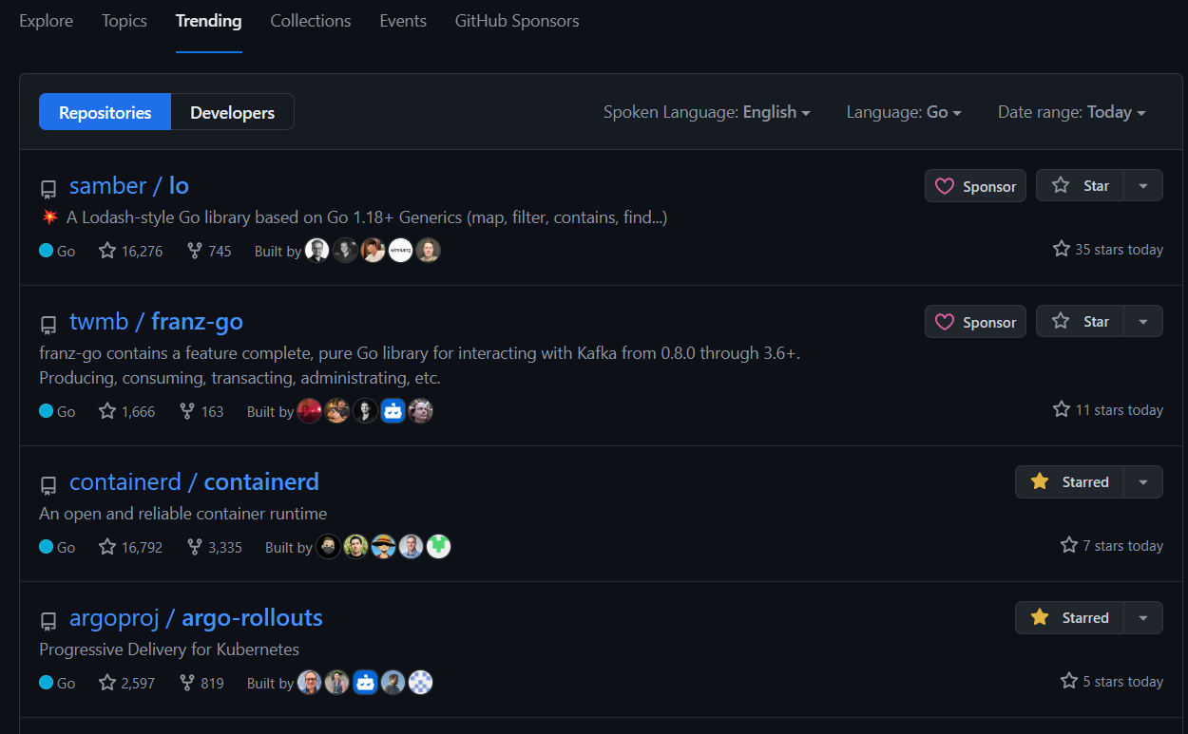

Slide 62
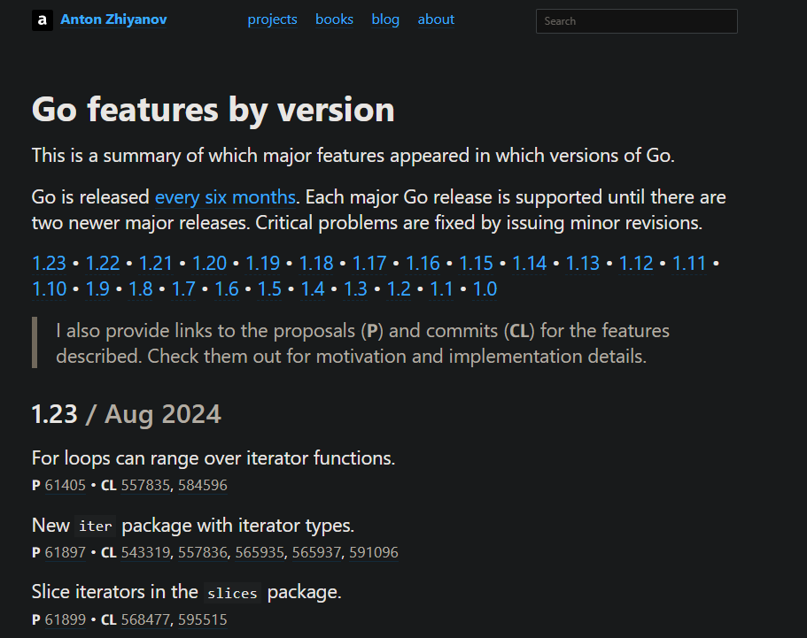

Slide 63
Questions?
SECTION SIX

